Slide 1
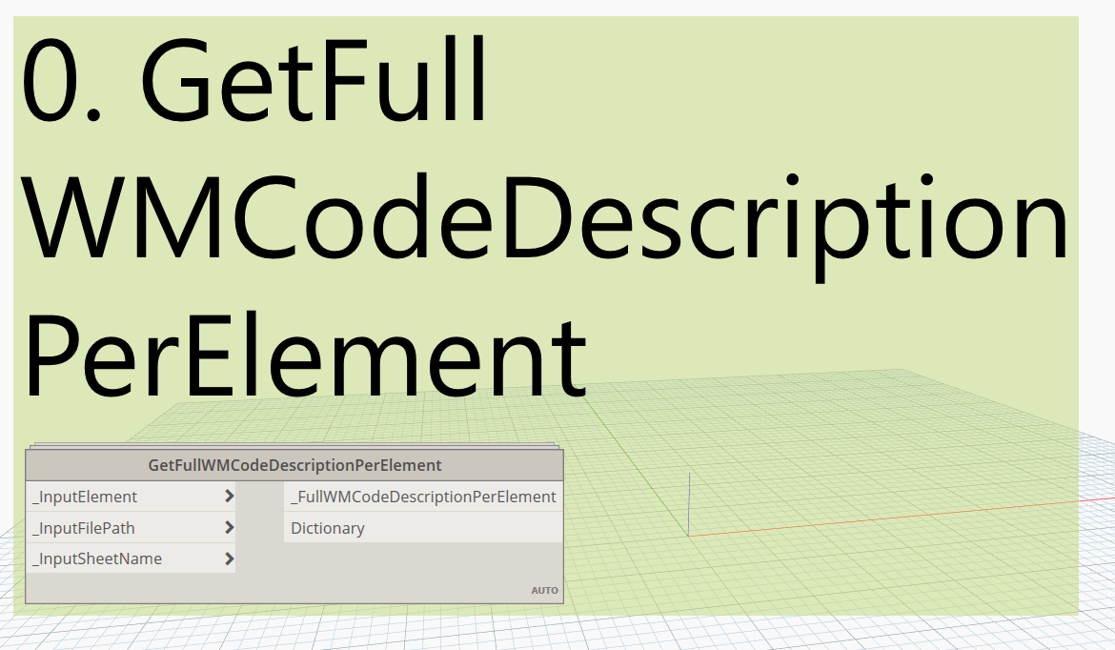

Slide 2
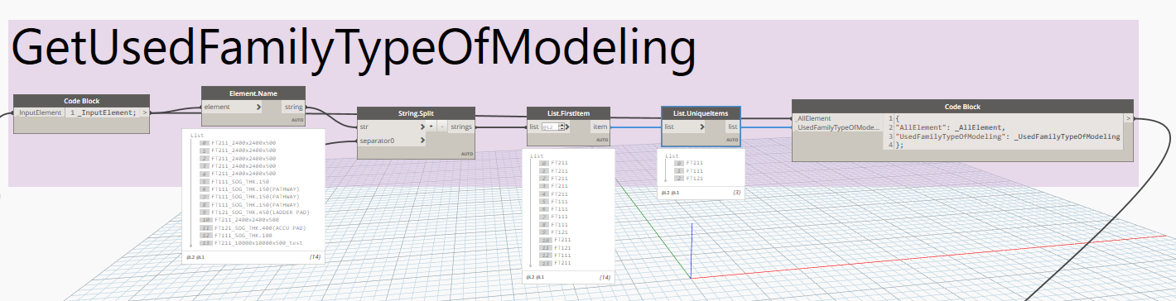

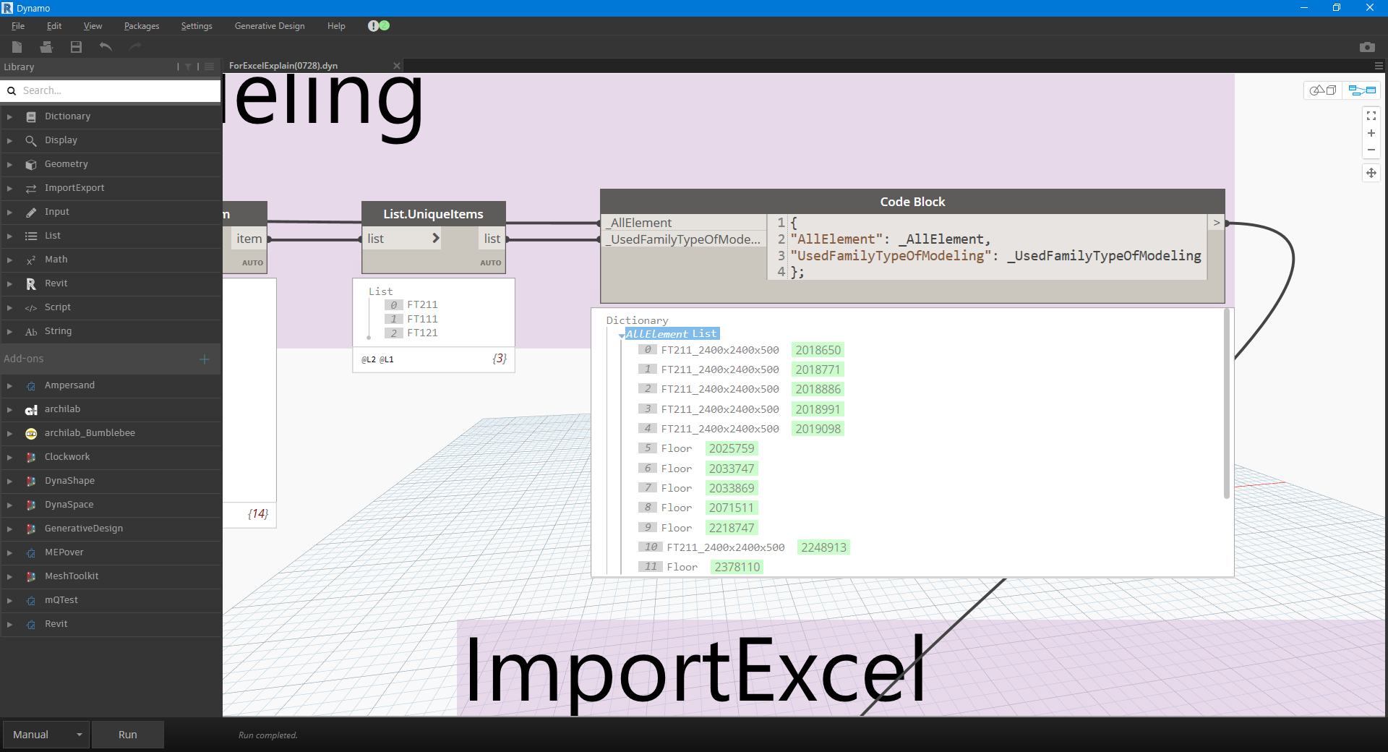
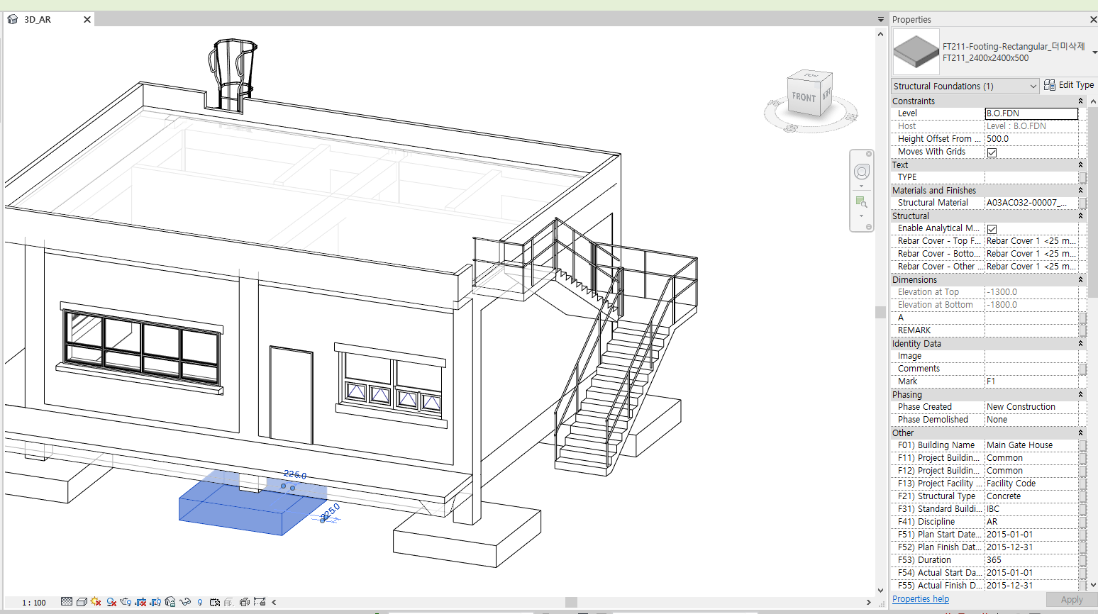
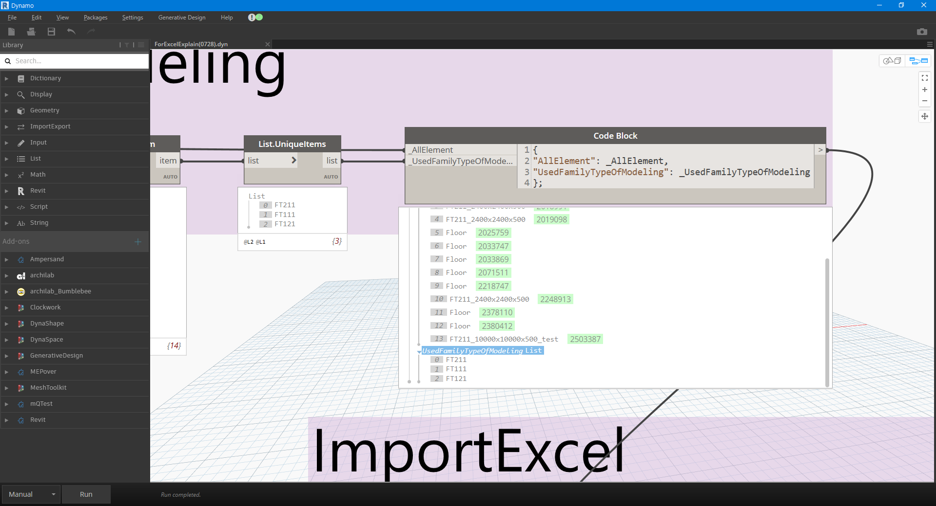

Slide 3
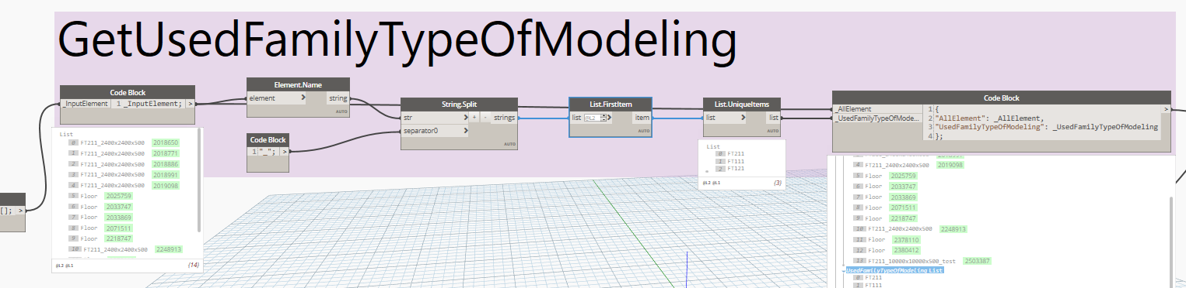

Slide 4

<Dictionary>
<Dictionary>
Key1: Value1,
Key2: Value2,
Key3: Value3
.
.
“가다”: “Go”,
“멈추다”: “Stop”,
“즐기다”: “Enjoy”
.
.
Hey, Dictionary~
Show me the
“즐기다”.
It is “Enjoy”.

Slide 5
:
=
,
:

Slide 6
<Dictionary>
<Dictionary>
Key1: Value1,
Key2: Value2,
Key3: Value3
.
.
,
:
:
Hey, Dictionary~
Show me the
“즐기다”.
It is “Enjoy”.

Slide 7
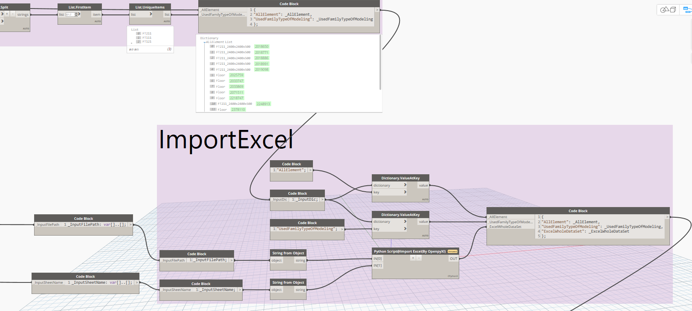
Hey, Dictionary~
Show me the
“AllElement”.

Slide 8
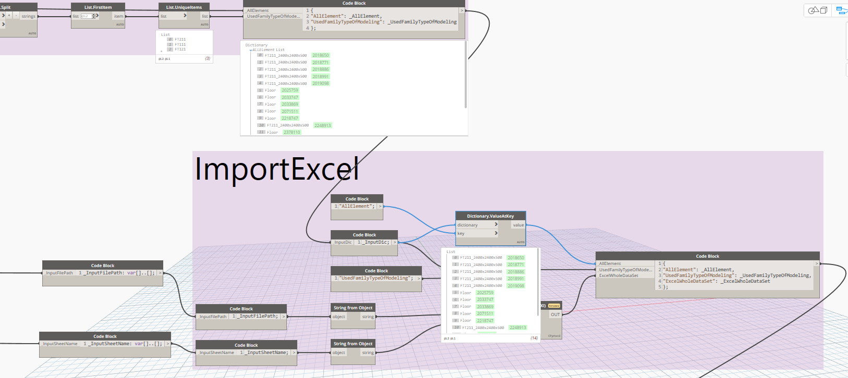
It is

